Slide 1
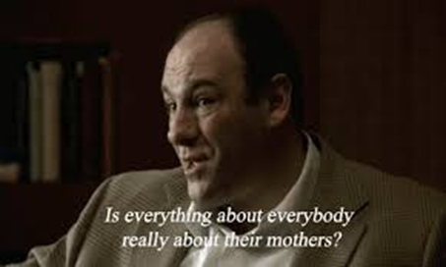
Mental Health 101
Jackie Thomson, MSW

Slide 2
Am I mentally healthy?
Being mentally healthy is not the absence of emotions: fear, anger, sadness or grief (i.e. life events) but possessing sufficient resiliencies to cope and restore balance.
Coping skills: walking, running, sports, meditation, counseling, music, hang w/ pet, focus on a task(cleaning or organizing), BREATH
What things help you relax?

Slide 3
Mental Illness
Illnesses/disorders that affect your mood, thinking and/or behavior (usually a combination).
Difficulties managing responsibilities of daily life and/or coping with incoming stressors
Can be chronic(long-lasting), temporary (short-term), situational(too much at one time), mild or severe.

Slide 4
Symptoms
Persistent sadness that lasts two weeks or more.
Withdrawing from or avoiding social interactions.
Hurting oneself or talking about hurting oneself.
Talking about death or suicide.
Outbursts or extreme irritability.
Out-of-control behavior that can be harmful.

Slide 5
Mental Illness
State of being not as well as one would want.
Mental disorders are not caused by character flaws. They have nothing to do with being lazy or weak.
It’s not weak to ask for support!
If you broke your arm, do we say just tough it out and get over it? No, we go to the doctor and there is no shame in that. Yet, different for our mental health.

Slide 6
Youth: Boundaries, safety and mental health
Minors: individuals under the age legally recognized as an adult. USA<18.
It is about vulnerability!
Can be easy to forget during adolescence.
Adolescents become stronger and more independent before they have developed good decision-making skills. A strong need for peer approval may tempt a young person to take part in risky behaviors.
Seeking approval can be impulsive. Critical thinking skill not fully developed
Brain not fully developed until 25yo

Slide 7
Signs of abuse or neglect:
Withdrawal from friends or usual activities.
Changes in behavior — such as aggression, anger, hostility or hyperactivity — or changes in school performance.
Depression, anxiety or unusual fears, or a sudden loss of self-confidence.
Sleep problems and nightmares.
An apparent lack of supervision.
Mandatory Reporting: Having reasonable cause to believe that any child you come in contact has suffered abuse or that any person with whom you come in contact has abused a child.
#1-866-363-4276 or 1-866-END-HARM.
“what if I’m wrong?”, “what if they don’t trust me again?” “Don’t tell my parents.”
Worse to not report and you are responsible for their safety not their friend.

Slide 8
What do I ask?
Do you feel safe going home?
Is anyone hurting you at home?
Do you think you might be hurt if you go home?
Are you worried about hurting yourself?
Is there someplace safe you can stay tonight?
Bring in the parent/guardian(s) or another professional (CPS)!!!
Problem solve while setting limits is a MUST. You are an adult with a minor. You cannot take them anywhere or do anything without their guardian’s permission.

Slide 9
Resources
211
Lines for life
#800-273-8255 or text ‘273talk’ to 839863
Local CPS
#1-866-363-4276 or 1-866-END-HARM.

Slide 10
Questions?

